Slide 1

Welcome to Moore Class
Year 3/4

Slide 2
Year 3/4 Team
Miss Fitch – Class Teacher
Mrs O’Brien – Teaching Assistant (M-Fri 9:40-3:15pm)
Mrs Witt-Morris – Teaching Assistant (M & Th 9:00-12:00)
Mrs Rowbotham – Teaching Assistant (W & Fri 9:00-12:00)
Mrs Humberstone – Teaching Assistant (Tu 9:00-9:40)
Mrs Bass - PPA Cover (Thursday pm)

Slide 3
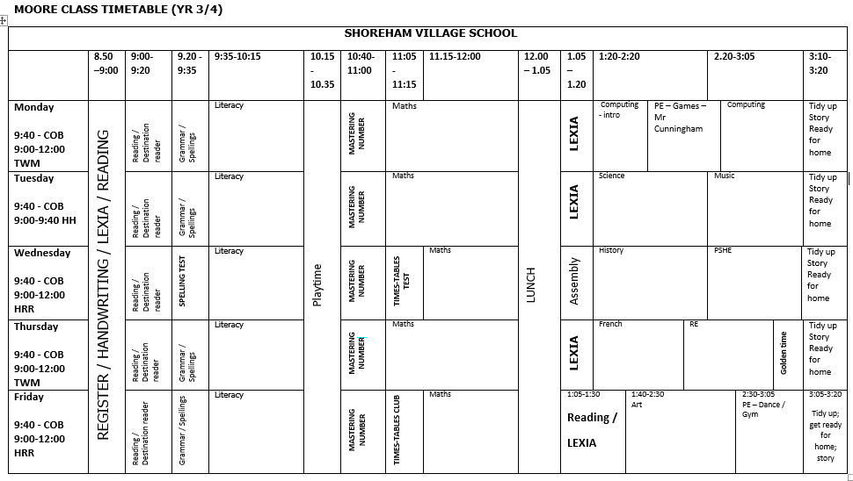

Slide 4
Reading
Please sign reading records every time your child has read (daily)
These will be checked frequently.
100 signatures = a book!
Please ensure that your child reads every day (10 minutes) as it really helps in many areas of the curriculum.
Learning key words and asking questions about the books that they are reading.
The school is having a big push on reading so we would welcome anyone who is able to come in to school and listen to children read.

Slide 5


Slide 6

FIFTY BOOKS TO READ BEFORE YOU LEAVE

Slide 7
Literacy
Areas of learning this term – Escape from Pompeii and Instruction writing
Spellings – test on a Wednesday and new spellings to be given out on Fridays
Big Writing – Vocabulary, Connectives, Openers and Punctuation.
Handwriting - cursive
Expectations of presentation
Writing for a purpose – making links
Guided Reading – Destination Reader
Core skills literacy – grammar, handwriting, spelling
LEXIA – online programme – each child is set there level to start at automatically.

Slide 8
Numeracy
Areas of learning this term – Place Value, Number – addition and subtraction.
Mastering Number – Multiplication and times-tables understanding.
Real life problem solving
Written and mental strategies
Justifying / Reasoning
Presentation of work
To know by heart all the times tables up to x12 by the end of year 4 or sooner (daily practice).
Times-Tables Club (Badges)
Mathletics
Purple Mash – times-tables

Slide 9
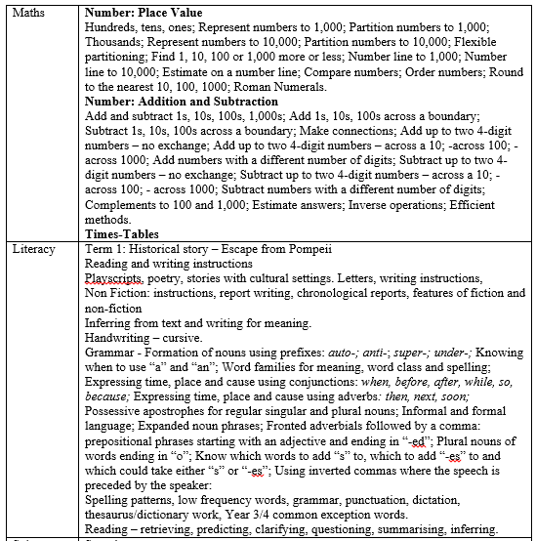
TERM 1

Slide 10
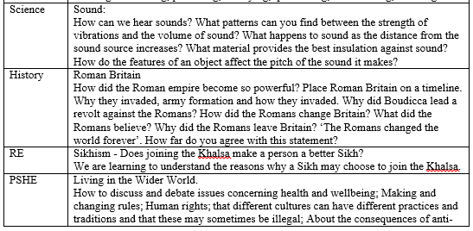
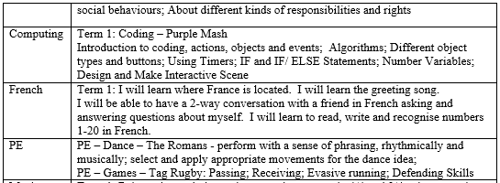

Slide 11
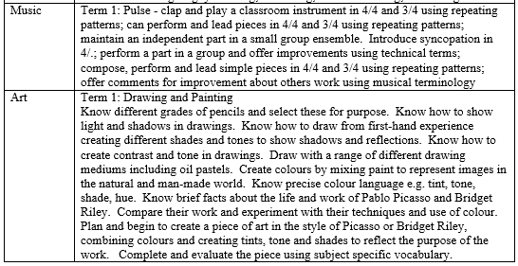

Slide 12
Class Webpage
The Moore Class webpage on the school website aims to have copies of:
The spellings for this term.
The homework topic grid.
The list of the Year 3/4 spelling and reading words.

Slide 13
Homework
Maths homework will be given weekly on a Friday
Topic homework. They may choose a minimum of 3 activities to complete from the homework chart – some may take 2 weeks to complete.
It must be handed in by the following Wednesday
Weekly Spellings and sentences relating to grammar work being covered at school
Times table practise
Daily reading
Mathletics, Purple Mash and LEXIA logins will be stuck in the front of their reading records.

Slide 14
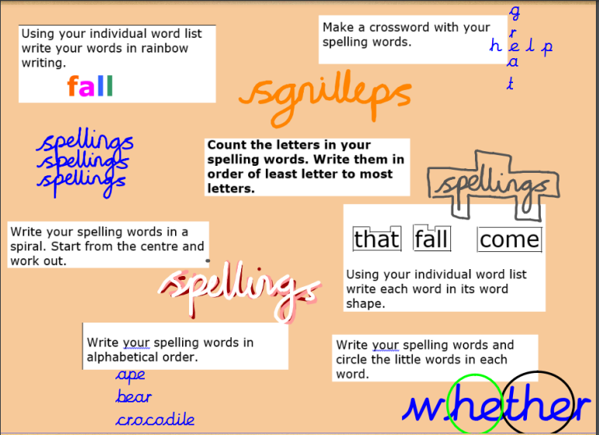

Slide 15
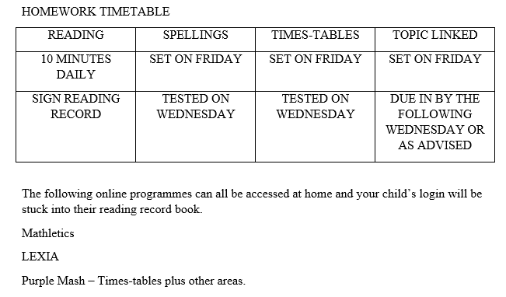

Slide 16
Physical Education
Monday and Friday – come to school in PE kits.
Outside Learning
We aim to use our outside area more for learning therefore please can they always have a pair of wellies / shoes suitable for the wet and mud in school

Slide 17
Healthy Minds
Water bottles – with water only. They have these on their desks all day
Morning snack - fruit
Healthy lunchboxes
Healthy School Meals

Slide 18
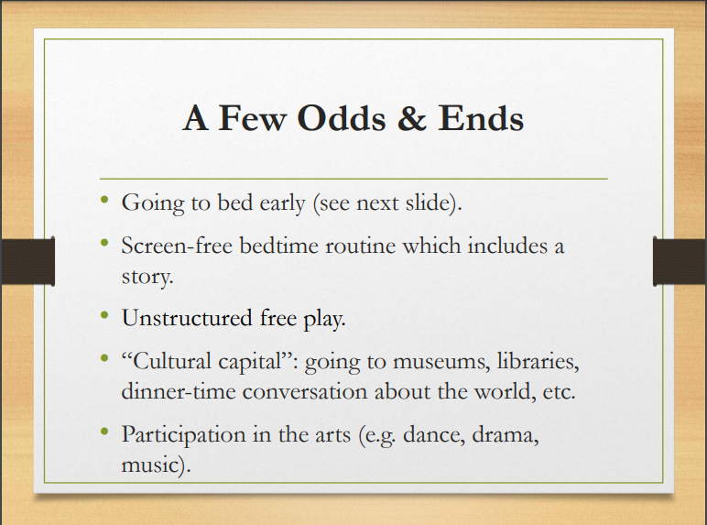

Slide 19
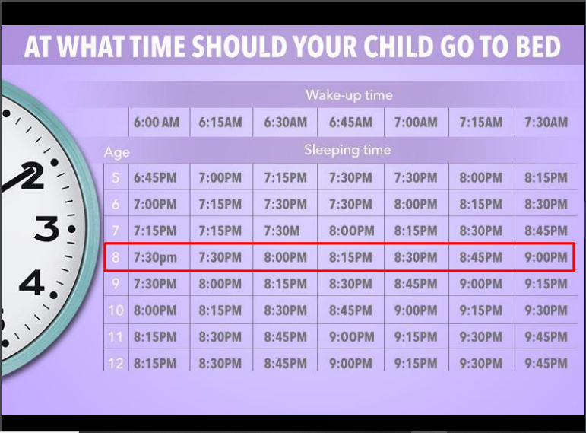

Slide 20

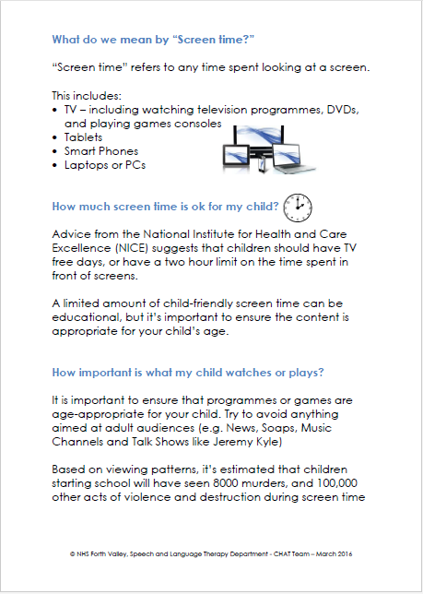

Slide 21
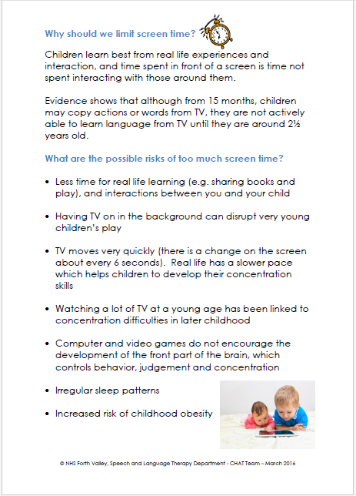
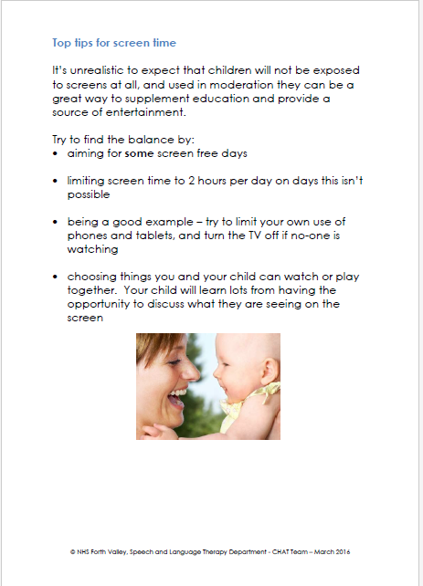

Slide 22
Uniform
Please ensure uniform is always worn.
Hair needs to be tied back if necessary with black, brown or green hair bands. Hair accessories ie: clips also need to be these colours.
Earrings – studs only please and they need to be able to remove these for PE, or not wear them on PE days, and have a pot to put them in.

Slide 23
Classroom Plan
Developing independence
Responsibilities to take care of their own belongings, letters, homework and PE/ Games kit
To ask for help whenever the children require it

Slide 24
Behaviour and Discipline
Positive discipline
Good to be Green – no longer displayed in class. If a child gets a red card they will miss 10 minutes of playtime the next day, during which time they write a reflection sheet. A yellow card is 5 minutes though a yellow card can be turned around and then only 2 minutes are lost from playtime.
Bullying will not be tolerated.
If there are any issues please speak to us straight away. If we can deal with small issues sooner they will hopefully not escalate into something bigger. But we need to know. Please encourage your children to tell us if they have any problems and not wait to home-time to tell you first.
Golden Time is now earned each week by each class up to 20 minutes starting from 0 each week. It is no longer automatic.

Slide 25
Thank You
Thank you for attending and we look forward to getting to know you all!

Slide 26
