Slide 1
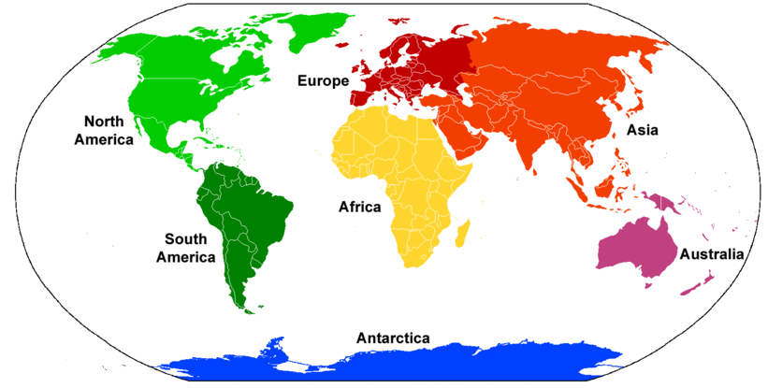
Seven Continents
Continent | A very large area of land, usually surrounded by the sea, and containing different countries.
North America | Third largest continent Contains the United States of America, but also Canada, Greenland, Mexico, Greenland and 18 other countries. Most people speak English, Spanish or French.
South America | Fourth largest continent. Contains the longest river, highest waterfall, and the longest mountain range Contains the worlds largest rainforest (the Amazon rainforest).
Europe | Second smallest continent Humans first travelled to Europe about 35,000 years ago. European countries conquered much of the world. The United Kingdom is in the continent of Europe.
Africa | Second largest continent Has the most countries (55). The oldest human fossils and skeletons have been found in Africa.
Asia | The largest continent. It contains the most people (biggest population). Also includes lots of mega-cities (E.g. Tokyo in Japan, Beijing in China, Delhi in India).
Australia | Smallest continent Sometimes called Australasia or Oceania. Contains Australia, New Zealand, and many islands.
Antarctica | Third smallest continent. Extremely cold, covered in ice. Doubles in size in winter when the seas freeze. Contains 90% of the world’s ice. No humans live in Antarctica permanently.
Asia | Great Wall of China, Taj Mahal, Burji Khalifa
Africa | Victoria Falls, Mount Kilimanjaro, Valley of the Kings
North America | Yosemite Falls, Barringer Crater
South America | Naica Cave, Monteverde Cloud Forest
Antarctica | McMurdo Research Station, Mount Erebus
Europe | Colosseum, Eiffel Tower, Eurotunnel
Australia | Sydney Opera House, Great Barrier Reef

