Slide 1
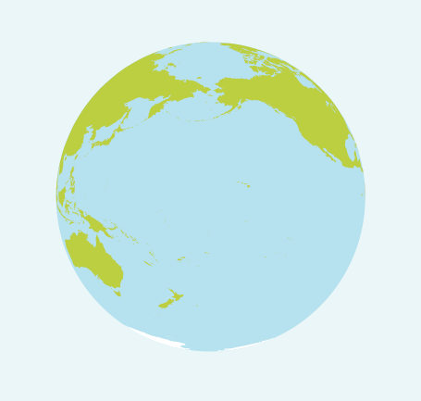
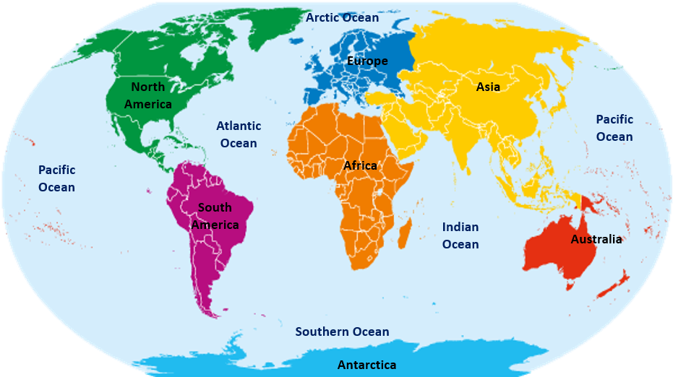
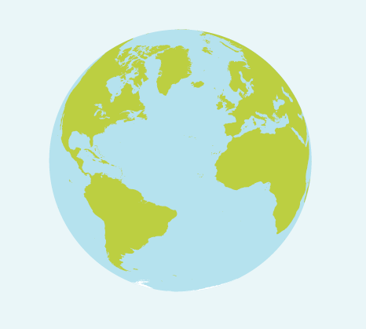
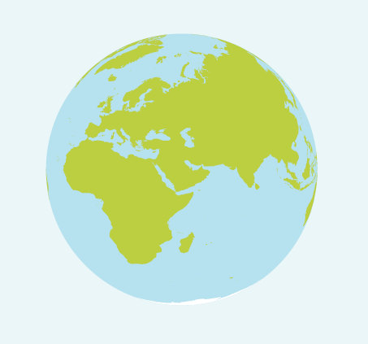
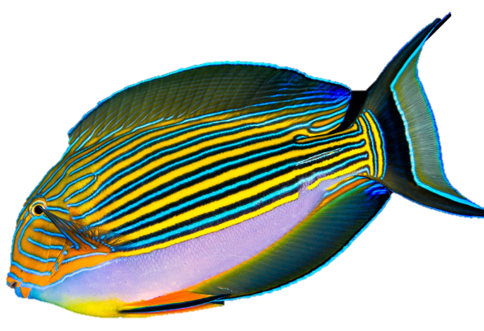
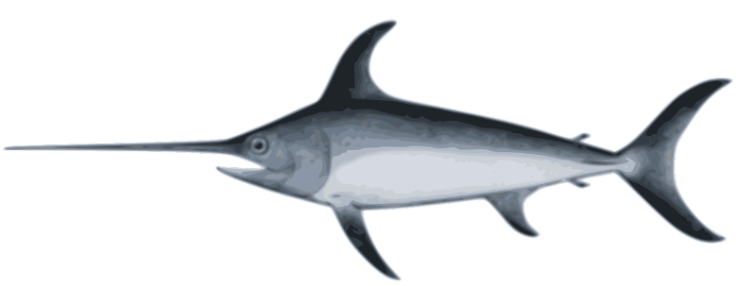
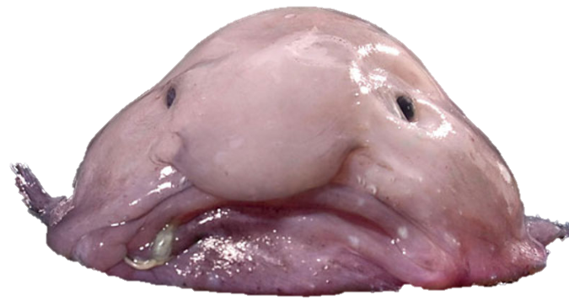
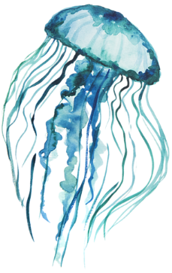
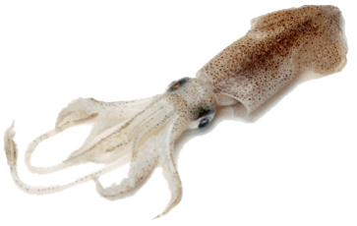
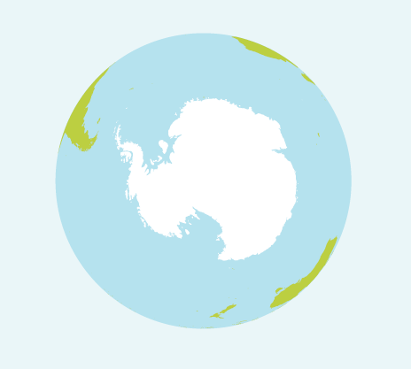
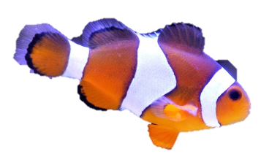
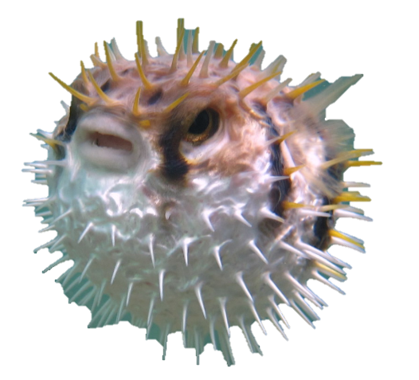
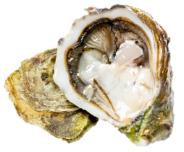
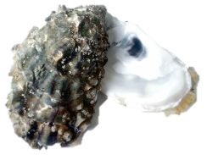
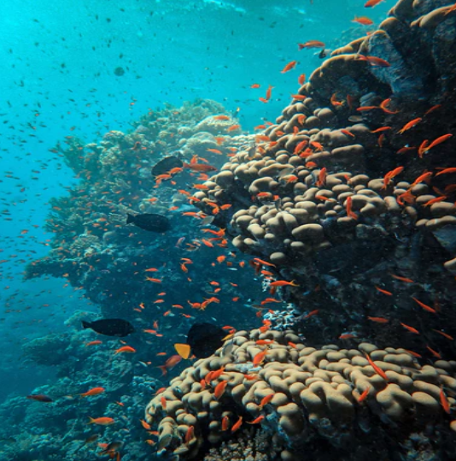
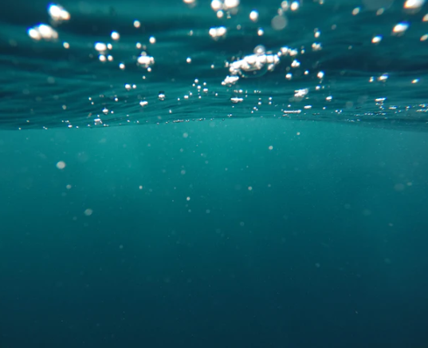
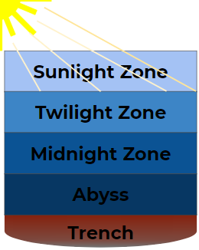
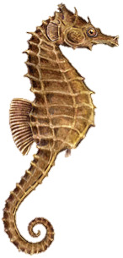
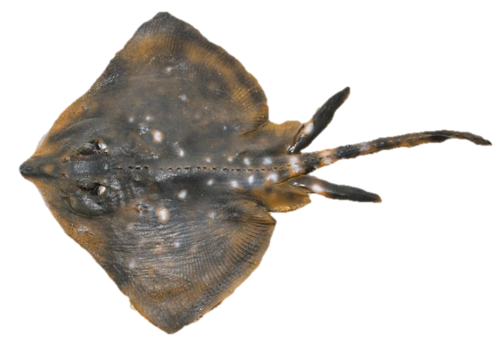
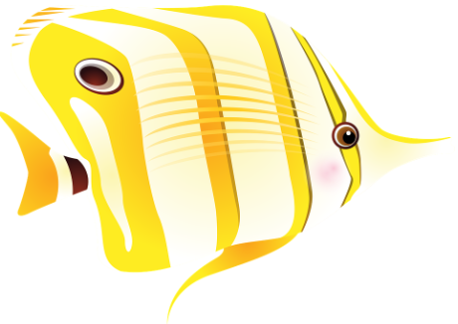
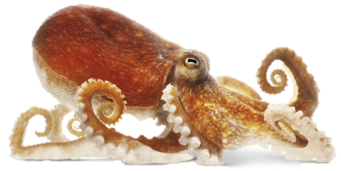
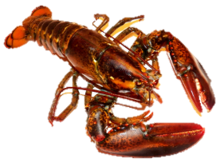
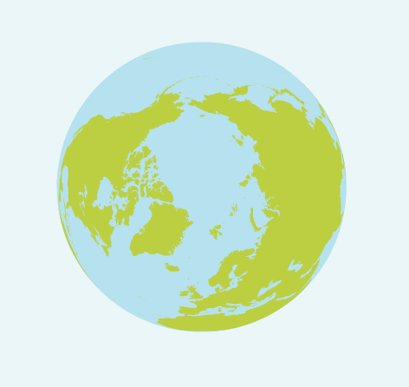
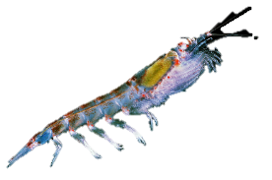
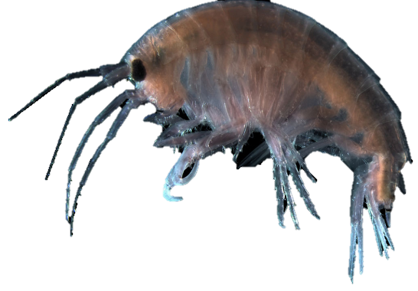
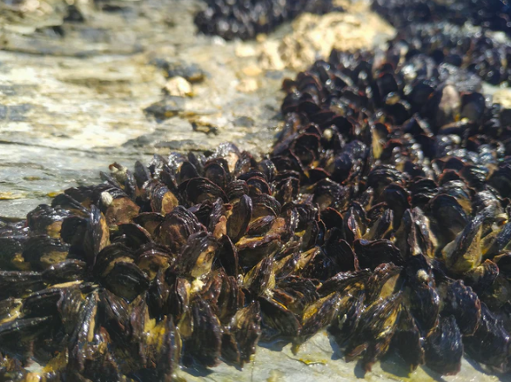
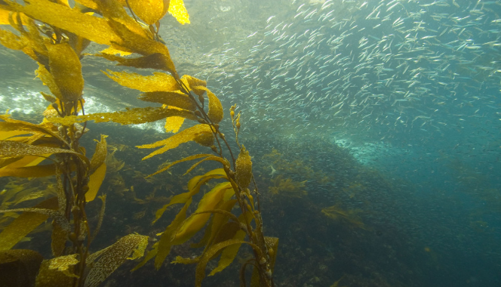
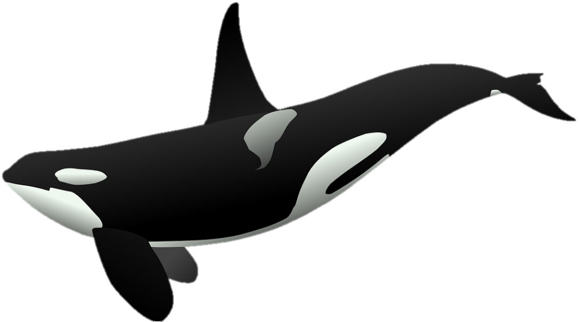
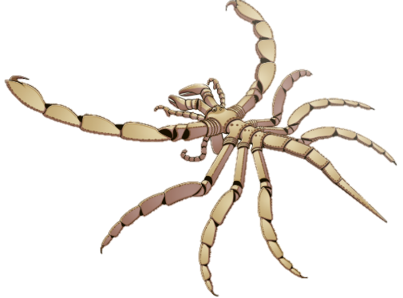
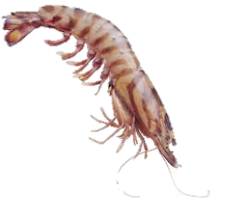
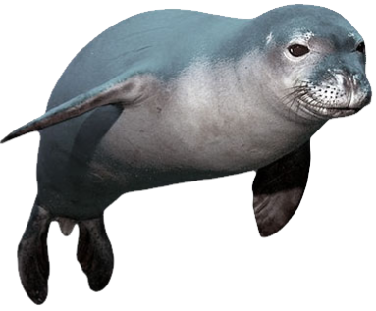
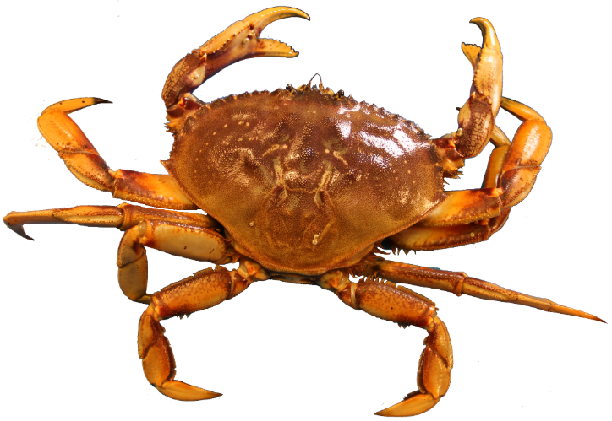
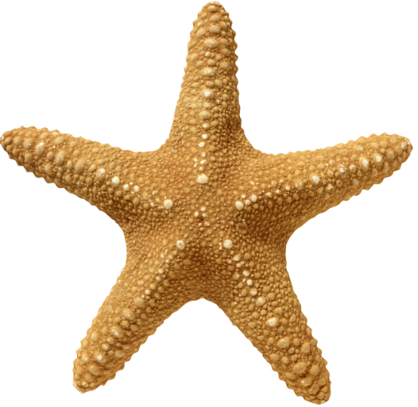
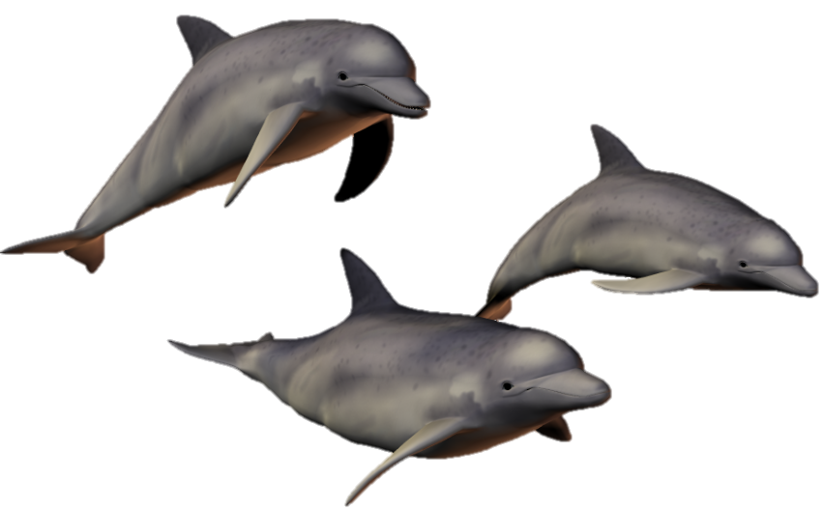
Oceans and Sea ¦ Year 1 ¦ Summer 1
VOCABULARY
Ocean | a huge body of salt water.
Sea | where land and ocean meet.
Habitat | where animals and plants live.
Bioluminescence | an animal creating its own light.
Gills | organs that allow fish to breath oxygen under water.
Continent | a large area of land.
Gills | an organ to help animals breathe underwater.
Mammal | an animal with warm blood and lungs.
Fish | a cold blooded animal with gills and a skeleton.
Crustacean | a cold blooded animal with a hard skeleton on the outside of its body.
Molluscs | a cold blooded animal with gills, some live inside a shell.
PACIFIC
ATLANTIC
ANIMALS IN THE OCEAN
INDIAN
FISH
jellyfish
OCEAN HABITATS
LAYERS OF THE OCEAN
acanthurus
swordfish
blob fish
CORAL REEF
clownfish
pufferfish
oyster
sea
horse
octopus
mussel
squid
stingray
butterflyfish
MOLLUSCS
SOUTHERN
OPEN OCEAN
CRUSTACEANS
ARCTIC
krill
OYSTER REEF
lobster
plankton
sperm whale
sea
spider
killer whale
crab
seal
shrimp
KELP FOREST
star fish
dolphin
MAMMALS

Slide 2
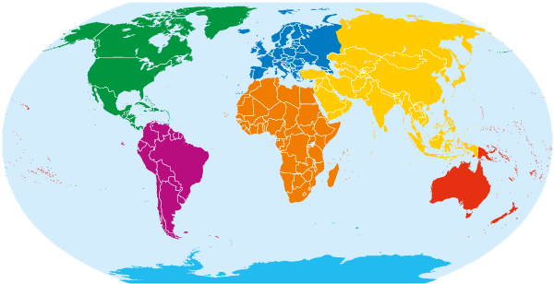
Arctic Ocean
Europe
North America
Asia
Atlantic Ocean
Pacific Ocean
Pacific Ocean
Africa
South America
Indian Ocean
Australia
Southern Ocean
Antarctica

