Slide 1
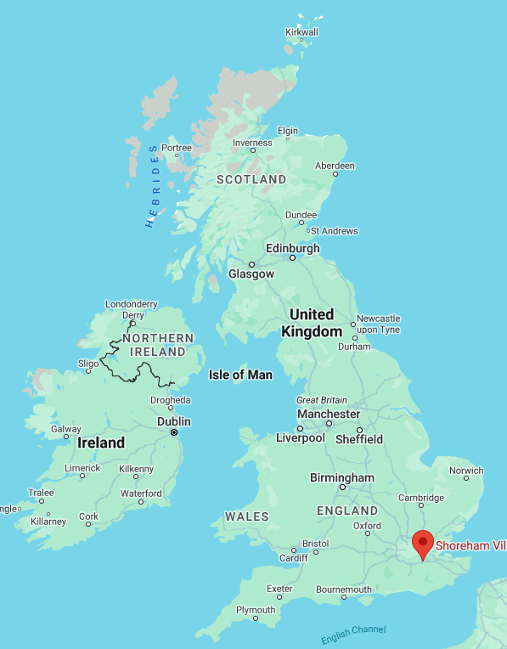
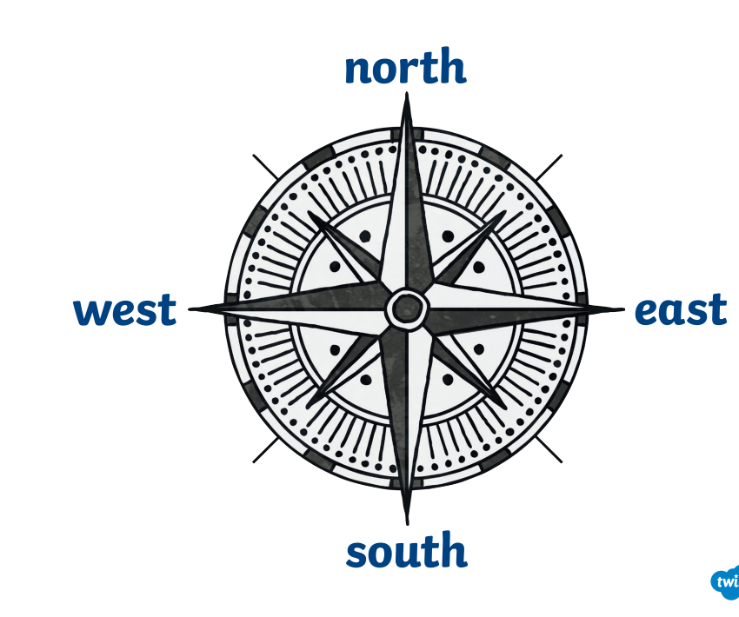
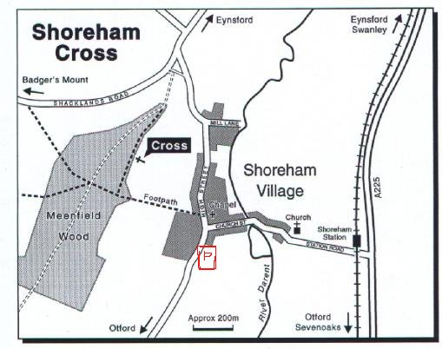
Fieldwork
Key Words
Sketch Map | A simple map with only basic details.
key | Helps us understand map symbols. Also known as a legend.
Compass rose | This is printed on a map to show different directions.
Map symbol | A picture or a sign on a map that represents something else.
Route | A way of getting from a start point to a finish point
Compass | A tool which shows people which direction they are travelling in and helps them find their way.
Climate | The usual weather conditions of an area.
You are here.
The trainline
Natural features | Man made features
River, hills | Shop, church, museum, park, monument
Countryside | Town
Land and scenery of a rural area. These places have lots of fields and farms. | A built-up area. These places have lots of houses and shops close by to each other.

